Slide 1
Final Project Data Science & Machine Learning Bootcamp - Remote
Tiago Santos
2025

Slide 2

Project
Data - Reservation report from an Apartment Hotel
EDA - Use to analyse the house keeping services in a Hotel
Create a ML model to predict HK services
Create a dashboard in tableaux
App for guest information's
Notes:
This project is divided by Two parts:
EDA part is the analysing a data set “reservation data” and data transformation to create a ML model that can predict House Keeping services. – could be improved for the future.
**resv_main.ipynb **
App guest service information aboutthe “Orange” hotel unit. For this part create a rag_main code and has a directive for the answers create an md file hotel_info.
**rag_main copy.ipynb **
**app.py**
**hotel_info **

Slide 3
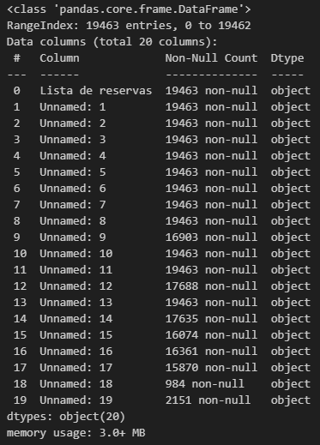
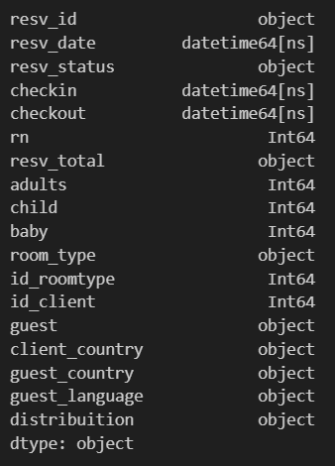
Data Cleaning
creating new columns names
Converting data types,
Clean empty spaces
Column standardization

Slide 4
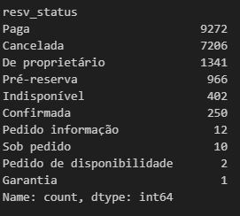
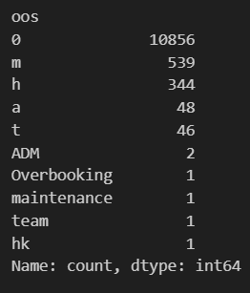
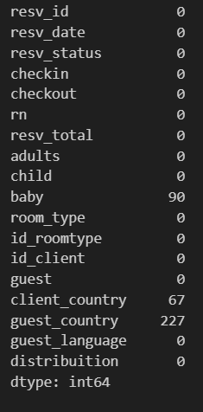
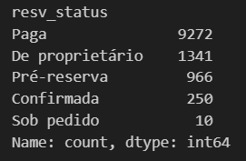

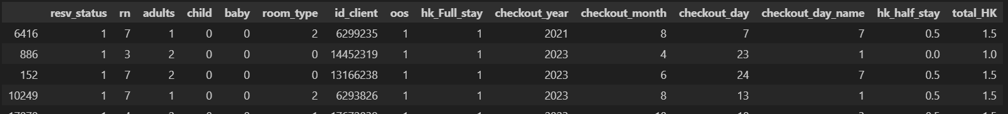
Data Cleaning
*Replacing some value counts
*Drop some rows Maintenance, cancelation, request´s reservations/ block´s
* Drop some categorical columns
Refiled baby, guest country
Mapping – Room Types, Resv Satus,
Changing checkout date
Copy
Generate new features – Hk full stay (end of reservation) and Hk half stay (after 3 day’s), Total HK (sum of hk full stay and hk half stay)

Slide 5
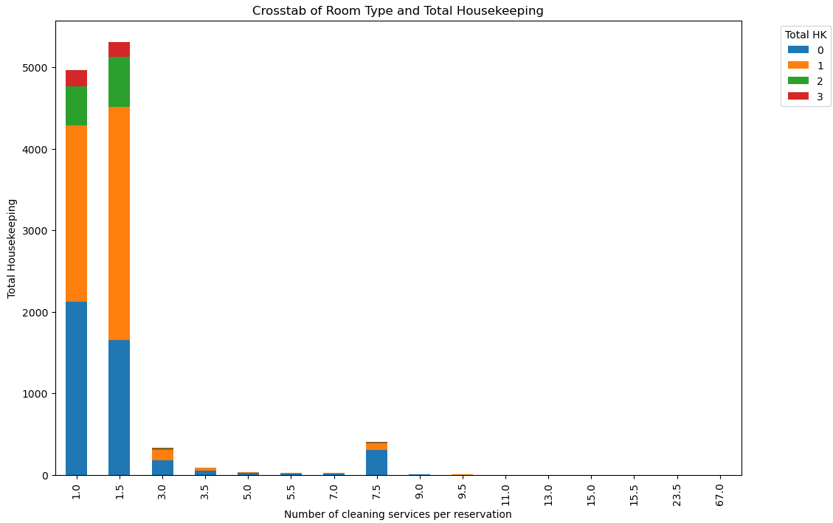
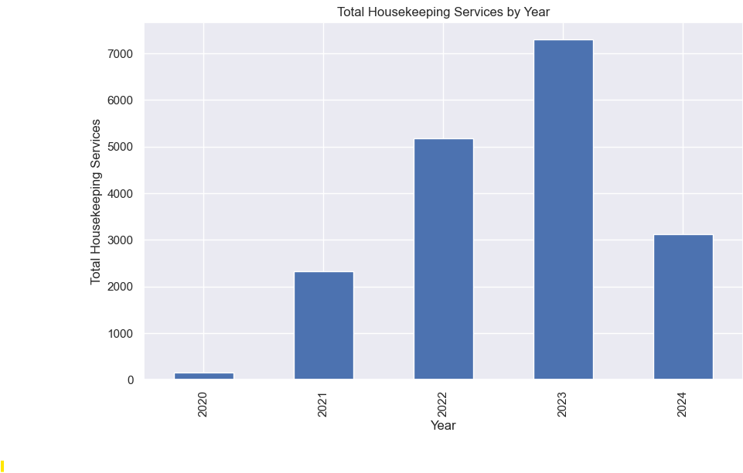
EDA

Slide 6
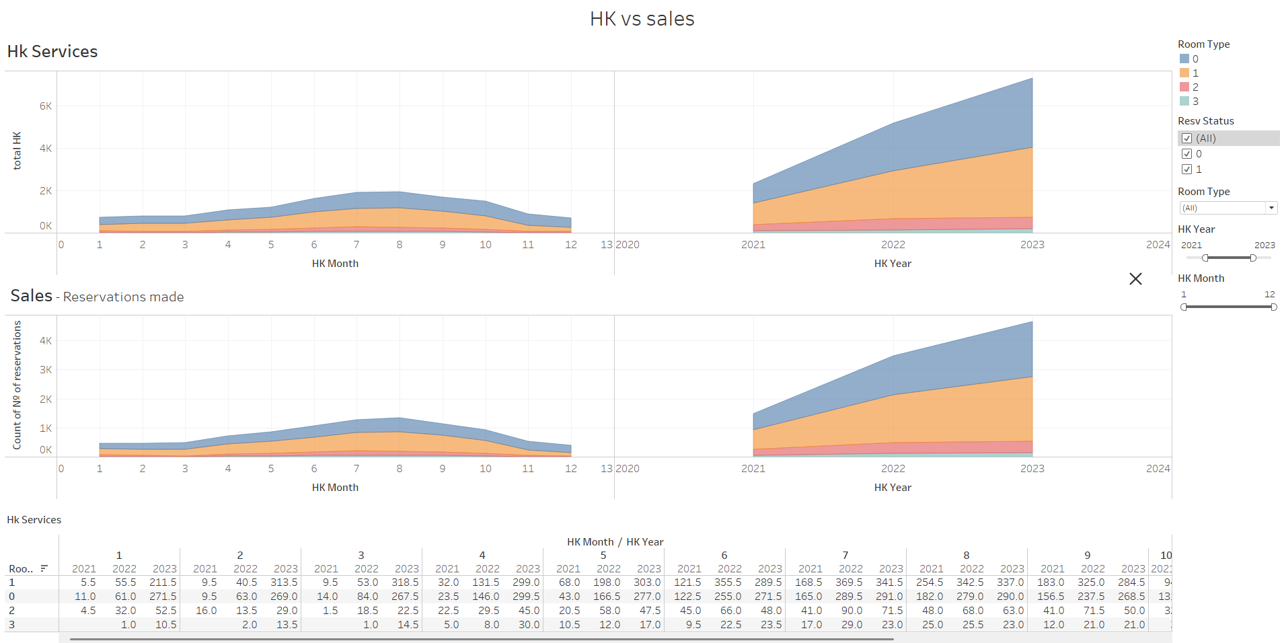
EDA - tableau

Slide 7
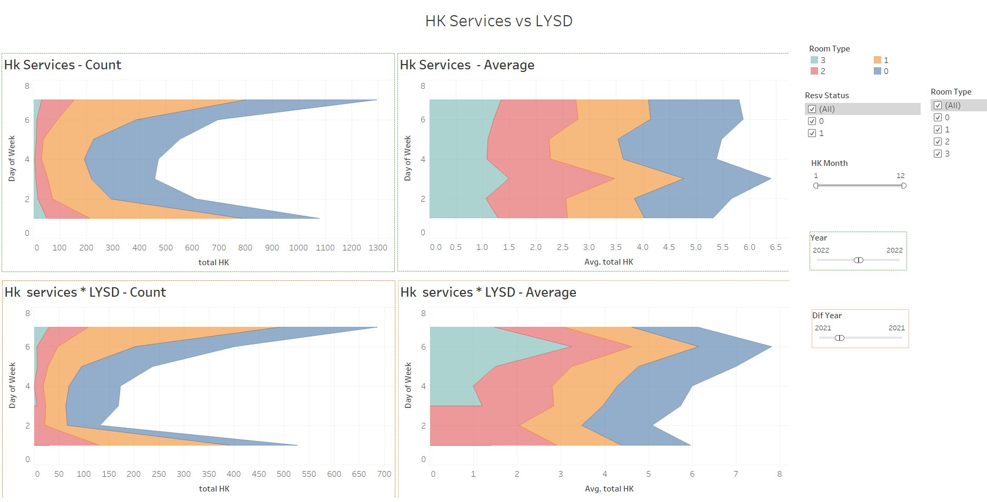
EDA - tableau

Slide 8
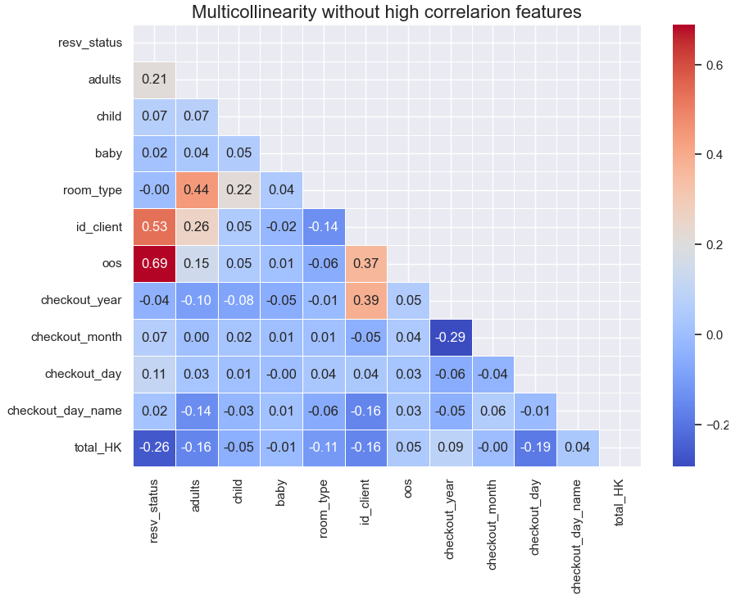
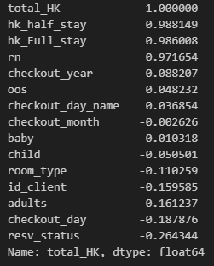
Correlation & multicollinearity

Slide 9



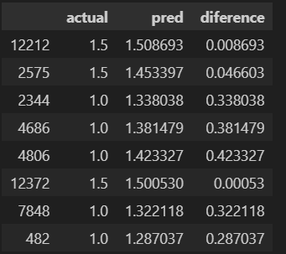
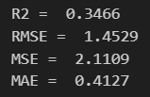
Models
Linear regression
Decision tree
Xgboost – the best model

Slide 10
Data & future improvements
Create new features – generating new KPI´s :
- Average clean per room type
Time per cleaning By defining av. time cleaning by room types
How many team members is needed for each day
Try news models, hipertuning…
** form this kind of approach I’ve secured many jobs positions and also create new ones**

Slide 11
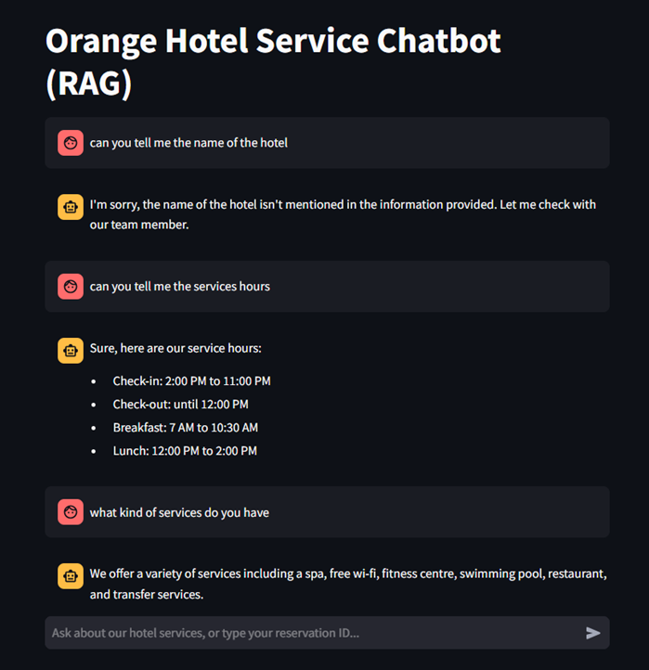
chatbot
It´s Working! ☺

Slide 12
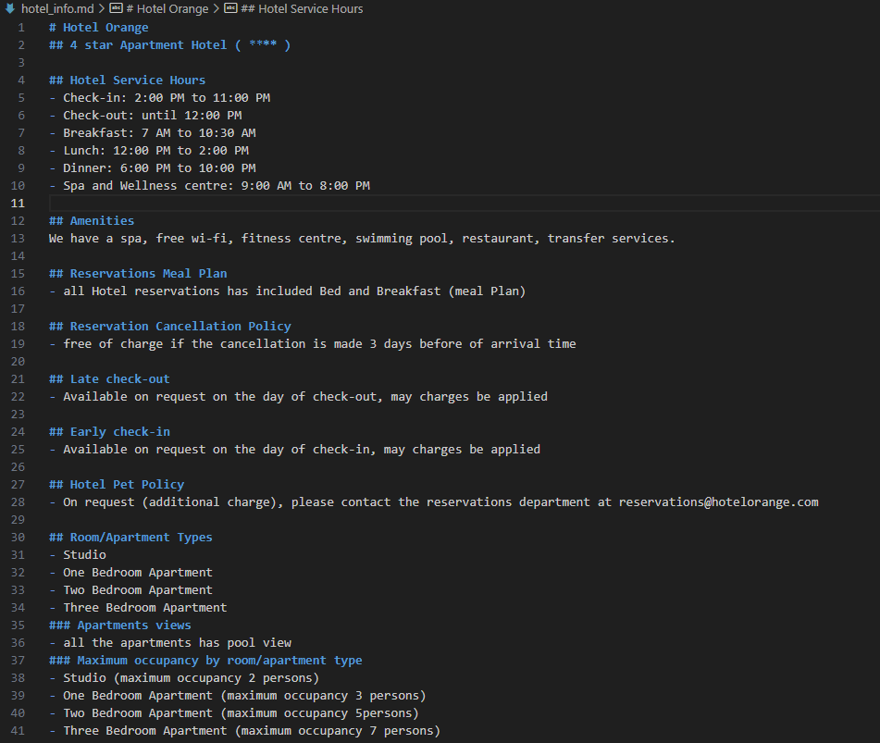
chatbot
Load my data set – Clean . csv
Load my hotel information. Md file
Split into chunks
Embeddings vectors with OpenAI and Chroma DB
Function to look for the reservation
Create the Streamlit app

Slide 13
Thank you!

